Slide 1
Март 2015
Notes:
Hello, I am Roger Wallman, the product marketing lead for Avaya Scopia solutions. Today I am pleased to discuss Avaya’s Scopia V8.3 Feature Pack 2 Release including two new video conferencing endpoints along with some great new new functionality for the Scopia platform. My email rwallman@avaya.com is noted here in case you have any questions that I don’t get to in this presentation. Please feel free to contact either myself, or the product managers Roberto Fogliardi or Ofer Sova with any questions you may have at the conclusion of the presentation.

Slide 2

A Word from Our Lawyers
The information contained herein is provided for information purposes only and is intended only to outline Avaya’s presently anticipated general technology direction.
The information in the roadmap is not a commitment or an obligation to deliver any product, product feature or software functionality and Avaya reserves the right to make changes to the content and timing of any product, product feature or software release.
Prices for any future product or software included herein will be separately negotiated when and if such product or software becomes available.

Slide 3

На повестке
Дополнительные возможности
Новые терминалы
Улучшенные качества
Взаимодействие через WEB
Стриминг и запись

Slide 4
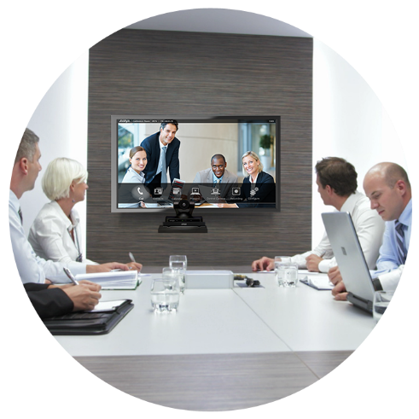

Новые терминалы
Notes:
Let’s start with the new endpoints and get into the meat of the presentation.

Slide 5
Показатели рынка
Терминалы
Средняя стоимость
Wainhouse Research Video Conferencing Endpoints, Infrastructure, and Services
Market Sizing & 5-Year Forecast – December 2014
Notes:
As you are likely aware, there is dramatic growth of desktop and mobile conferencing (I even skipped that slide), but its important to note that the conference room systems market is not going away. There is a still the need for high quality room system solutions with great audio capability and enhanced optics to support the needs of a conference room environment. In fact the unit sales of room systems is growing. Just last quarter unit sales of room systems hit an all time quarterly high at over 100K units. But clearly the other trend is a reduction of ASPs (average selling price) with systems becoming less expensive.
.

Slide 6
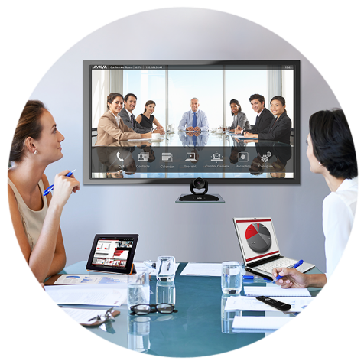
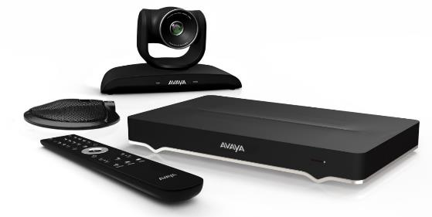
Представляем Scopia XT4300
Богатый функционал, выгодная стоимость
H.264 High Profile, SVC
Разрешение 1080p60
5x Оптический зум
  3x цифровой зум
1 монитор (по умолчанию)
  2-й опционально
1-но направленный мик
Передача контента без проводов
Встроенный MCU-4
The opportunity for personal workspace is now. Customers demand a rich, collaborative user experience that is interoperable and easy to use. In addition, we believe this transaction will leverage a highly-skilled, incredibly talented and experienced workforce ready to deliver video to enterprise customers
Mary Meeker, Morgan Stanley, Mar 2012
APL: $5,500
Mary Meeker, Morgan Stanley, Mar 2012
PN 55211-00014
Доступен с: 6 апреля, 2015
Notes:
In April, we will be offering the new Scopia XT4300. Very competitively priced it’s designed for the needs of small and mid-size conference rooms with 5x optical zoom camera and an optional 3x digital zoom booster. It will support dual 1080p 60 frames per second channels for both the video meeting in addition to shared content. The 4300 offers both H.264 High Profile and H.264 Scalable Video Coding. High Profile for bandwidth efficiency and SVC for error resiliency. The system will support a new wireless presentation feature that we’ll talk about in a minute. Options include the capability to support 2 displays, a 4 port embedded MCU along with the highly popular option enabling Scopia Desktop and Mobile users to connect to the embedded MCU. A very powerful system for a very affordable price of $5,500 APL.
MCU 4: $5,620
SMB 4: $9,165
Dual Display: $3,000

Slide 7
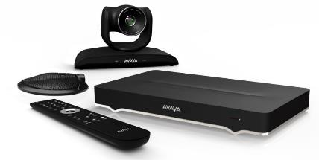
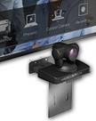
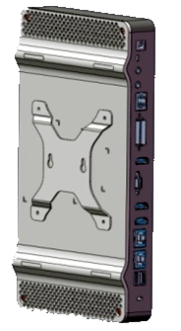
Scopia XT4300
Подробнее
Компоненты
  XT4000 терминал с базовым
  набором кабелей
  Flex камера (1080p60)
  + тройной кабель
  1-но напр. микрофон + кабель
  Упрощенный ИК пульт
Спецификация
  Разрешение 1080p60
  H.264 High Profile и SVC
  5x Оптический зум
  MCU4/SMB4 опционально
  Активация 2-го экрана опционально
APL: $5,500
PN 55211-00014
+ Крепление камеры
(опция)
$180
+ Крепление терминала (опция)
$244
+ Дополнительный набор кабелей
$367
Notes:
Getting to the details of the XT4300, the base system includes:
The codec and basic cables
1080p 60 camera with cable
1-way microphone pod with cable
And the new, simplified remote control
Specifications was we said in the previous slide:
Dual 1080p60 video resolution for the video meeting and content
H.264 High Profile for lower bandwidth utilization and SVC for network error resiliency
5x optical zoom on the camera, with 3x digital zoom available as an option
Optional embedded multi-party conferencing for up to 4 participants along with the addition option of support for Scopia Desktop and Mobile clients
The base system supports a single display, with the 2nd display optional
For wall mounting, there are brackets available for the camera, codec chassis, along with an optional cable kit.
The cable kit is designed for a system integrator and includes useful components to place the microphone and camera at a longer distance from the codec, add a second camera, connect a PC, add audio peripherals, and provide spares.

Slide 8

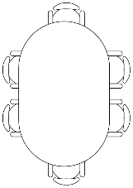



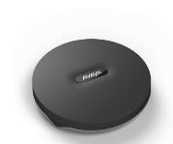
Scopia XT4300
3-х направленный микрофон (опция)
3-х направленный микрофон
Используется для:
  Покрытия комнат средних размеров
  При небольшом удалении говорящего
Микрофоны не могут каскадированы
PN 55511-00007
$800
Notes:
Standard with the XT4300 is a 1-way directional microphone pod. This 1-way pod can limit where meeting participants can sit in some applications.
A 3-way beam forming digital microphone pod is available as an option. This microphone provides additional room coverage and the digitally steerable beams do an excellent job of isolating the current meeting speakers from background noise – effectively bringing the speakers closer to the microphone.

Slide 9
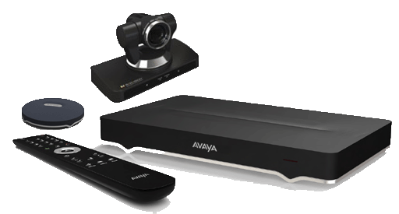
Представляем Scopia XT7100
Новый флагман в линейке Scopia для переговорных
H.265 HEVC, SVC
Разрешение 1080p60
10x оптический зум
Поддержка 2-х экранов
Подключение 2-х камер
Презентация без проводов
MCU 4/9 опционально
Аппаратное обеспечение с поддержкой будущих технологий.
The opportunity for personal workspace is now. Customers demand a rich, collaborative user experience that is interoperable and easy to use. In addition, we believe this transaction will leverage a highly-skilled, incredibly talented and experienced workforce ready to deliver video to enterprise customers
Mary Meeker, Morgan Stanley, Mar 2012
APL: $13,000
PN 55511-00001
Mary Meeker, Morgan Stanley, Mar 2012
Доступен к заказу с: 1 июня, 2015
Notes:
As we said a few minutes ago, the market for room systems is strong, and the need for the best capabilities in a conference room system isn’t going away.
With that in mind, we are introducing the new flagship of the Scopia line, the XT7100. An all new processing design, the system will support the new H.265 High Efficiency Video Codec (HEVC) video codec with up to 50% bandwidth reduction over H.264 High Profile and about a 65% reduction from H.264 AVC. With 1080p 60 frames per second quality and H.265 processing including Scalable Video Coding (SVC), the XT7100 will deliver the best experience available in the industry. It is also loaded with all the high end features you’d expect from Scopia.
The system is available with an optional 4 or 9 port embedded MCU along with the SMB option enabling Scopia Desktop and Mobile users to connect to the embedded MCU.
Additionally, the XT7100’s hardware ready is robust and ready for future capabilities through firmware upgrades.

Slide 10
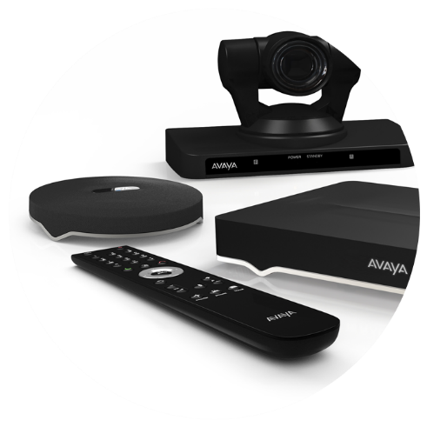

Scopia XT7100
Экономия до 50% полосы пропускания при H.265 HEVC
H.265
HEVC
High Efficiency
Video Coding
H.265
720p30 @256Kbps
1080p60 @1.1Mbps
Mary Meeker, Morgan Stanley, Mar 2012
H.264 Baseline Profile
H.264 High Profile
Mary Meeker, Morgan Stanley, Mar 2012
720p30 @768Kbps
720p30 @512Kbps
1080p60 @2.5Mbps
1080p60 @1.9Mbps
Notes:
Lets explore H.265 support with the Scopia XT7100.
The robust processing of the system supports H.265 High Efficiency Video Coding or HEVC. This provides up to a 50% reduction in bandwidth required over H.264 High Profile, and about a 65% reduction from H.264 AVC. This extreme bandwidth efficiency enables the Scopia XT7100 to deliver impressive performance in network applications and conditions where bandwidth is at a premium. With bandwidth the same, the XT7100 delivers significantly higher performance than systems only supporting H.264 High Profile or the more common H.264 AVC technology.
An example of this efficiency is that the Scopia XT7100 supports a 720p30 HD call at only 256K.

Slide 11
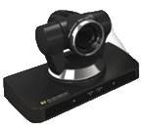
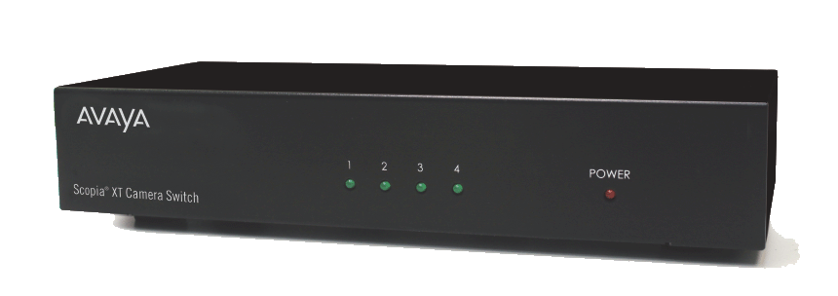
Scopia XT7100
Подключение камер
По умолчанию имеется 2 HDMI входа
Дополнительные 3 HDMI входа при использовании XT Camera Switch
  Поддерживается любое стандартное устройство 1080p
5 Scopia XT могут быть подключены к 1 терминалу.
Notes:
The Scopia XT7100 base unit now supports 2 HDMI inputs (as compared to the XT5000 supporting one).
Also with the camera switch, up to 5 cameras can now be connected and controlled from the system user interface and remote control.
This is a great enhancement for those deployments requiring more complex A/V room integrations with multiple video conferencing cameras or other HDMI video feeds such as media players, specialized scopes or other cameras.

Slide 12
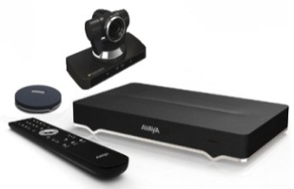
Scopia XT7100
Подробнее
Компоненты
  XT7000 терминал с базовым
  набором кабелей
  Premium Camera (1080p60)
  + тройной кабель
  Premium 3-х напр. Микр. + кабель
  Упрощенный ИК ПДУ
Спецификация
  Разрешение 1080p60
  H.265, H.264 High Profile, SVC
  10x оптический зум (40x общий)
  Опция MCU9/SMB9
APL: $13,000
PN 55511-00001
+ Крепление камеры
(опция)
$180
+ Крепление терминала (опция)
$244
+ Дополнительный набор кабелей
$367
Notes:
For the details of the XT7100, the base system includes:
The codec and basic cables
Premium 1080p60 camera with cable
3-way premium microphone pod with cable
And the new, simplified remote control
Reviewing the specifications:
Dual 1080p60 video resolution for the video meeting and content
H.265 for the highest performance using the least amount of bandwidth, SVC for network error resiliency, along with H.264 High Profile
10x optical zoom on the camera, with 4x digital zoom included for a total of 40x zoom.
Standard support for 2 displays.
Optional embedded multi-party conferencing for up to 4 or 9 participants along with the additional option of support for Scopia Desktop and Mobile clients
For wall mounting and system integration, the same brackets and cable kit available for the XT4300 work with the XT7100.

Slide 13
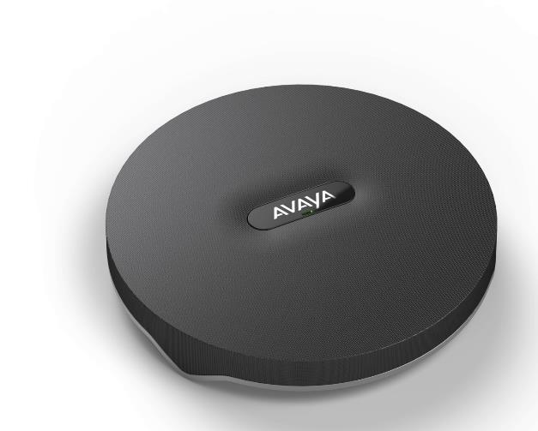
Scopia XT7100
Premium 3-х направленный микрофон
Поддержка всего слышимого диапазона частот
2x микрофона могут каскадироваться
Поддержка стерео
PN 55511-00007
$800
Notes:
Standard with the XT7100 is a premium 3-way beam forming digital microphone pod. This microphone provides digitally steerable beams that do an excellent job of isolating the current meeting speakers from background noise – effectively bringing the speakers closer to the microphone. The XT7100 supports cascading 2 Premium microphone pods which work in tandem – effectively providing a 6-way beam forming digitally steerable microphone.
This microphone has a frequency response from 50 to 22,000 Hz.
And is stereo ready if in the future, the XT7100 offers an upgrade to stereo capability.

Slide 14

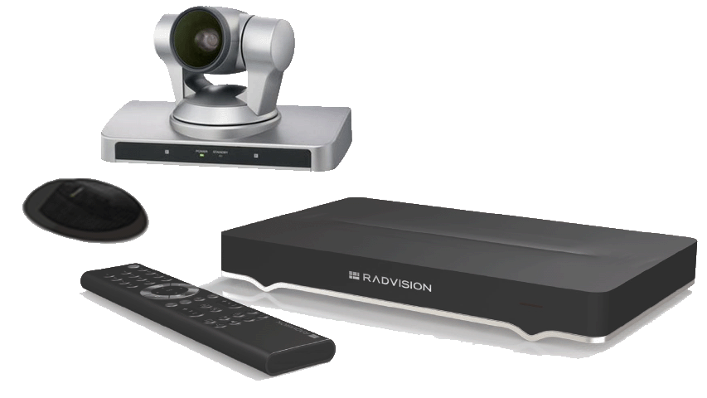



Scopia XT Портфолио Лицензии и Опции
V8.3 FP2
Функции | P/N | цена | XTE 240 | XT4200 | XT4300 | XT5000 | XT7100
Full MCU4 | 55111-00951 | $5,620 | $ | ✗ | $ | $ | $
Full MCU9 | 55111-00952 | $9,350 | ✗ | ✗ | ✗ | $ | $
Full SMB4 | 55111-00941 | $9,165 | $ | ✗ | $ | $ | $
Full SMB9 | 55111-00942 | $14,665 | ✗ | ✗ | ✗ | $ | $
Scopia Control | 55111-00917 | $610 | $ | $ | $ | Включено | Включено
2й LAN | 55111-00916 | $244 | Включено | $ | $ | Включено | Включено
2й экран | 55211-00914 | $3,000 | Включено | Включено | $ | Включено | Включено
Активация 1080p | 55111-00937 | $2,420 | Включено | NA | Включено | Включено | Включено
USB запись | 55111-00933 | $1,210 | $ | $ | $ | Включено | Включено
Набор кодеков (G.728 & G.729A) | 55111-00948 | $122 | $ | $ | $ | $ | $
Notes:
Included for your reference is a chart showing part numbers, pricing and availability of the most popular software licenses and options available for Scopia Executive Desktop and Room systems.
A point of clarification is that the SMB4 and SMB9 features are a combination of the 4 or 9 port embedded MCU along with support for Scopia Desktop and Mobile connectivity – including the clients for up to either 4 or 9 concurrent connected conference participants.

Slide 15
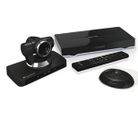


Scopia XT Room System Portfolio
Функция | XT4200 Малые переговорные | XT4300 Малые/Средние перег. | XT5000 Средние/Большие залы | XT7100 Большие залы
Видео | 720p60 | 1080p60 | 1080p60 | 1080p60
Микрофон | 1-но направл. 3-х напр. Опция | 1-но направл. 3-х напр. Опция | 3-х напр. + 2^{й} 3-х напр. Опция | 3-х напр. + 2^{й} 3-х напр. Опция
Опция MCU/SMB | ✗ | 4 @1080p30 | 4/9 @1080p30 | 4/9 @1080p30
Оптич/общий Зум | 5x 40x optional | 5x 15x optional | 10x/40x | 10x/40x
Поддержка H.265 | ✗ | ✗ | ✗ | ✓
HDMI входы | 1 | 1 | 1 (+3 опция) | 2 (+3 опция)
Запись | Включено | Включено | ✓ | ✓
Scopia Control | Включено | Включено | ✓ | ✓
2й LAN | Включено | Включено | ✓ | ✓
2й HD Выход (DVI) | ✓ | Включено | ✓ | ✓
Notes:
Another reference chart showing the Scopia XT room system portfolio with some key things to point out.
The Scopia XT4200 as the entry level system supports 720p capability, while the new XT4300 offers 1080p resolution.
Both the XT5000 and XT7100 include meeting recording to a USB drive or stick, Scopia Control which delivers advanced meeting control through an Apple iPad, and dual display support as standard.
The XT4300, XT5000, and XT7100 all offer optional embedded MCU capabilities to host multi-party calls.
And to wrap this slide up, the XT7100 is the only system to offer the H.265 video codec.

Slide 16
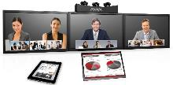
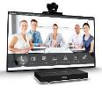







Scopia XT Telepresence
Оборудование поддерживающее
Видео
Scopia XT7100
Scopia XT5000
Scopia XT4300
Scopia XT4200
Scopia XT Executive 240
H175 Video Collaboration Station
E159/169 Media Stations
Avaya программные клиенты
Video Collaboration Server /
Endpoint for IP Office
16
Notes:
And here you have the full Avaya video endpoint portfolio from the pocket with soft clients on mobile devices to the boardroom with immersive, multi-stream telepresence.

Slide 17


Улучшение качества
Notes:
Now lets shift to enhancements to the quality of the experience.

Slide 18

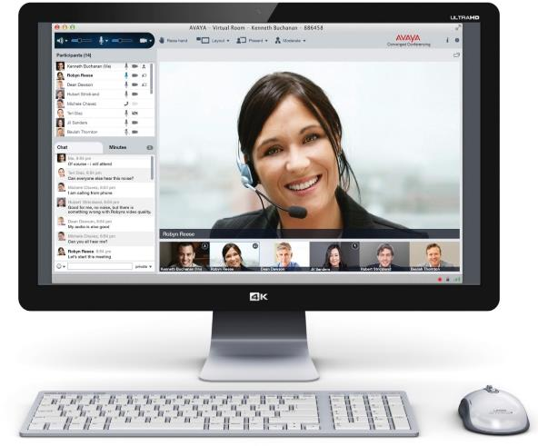
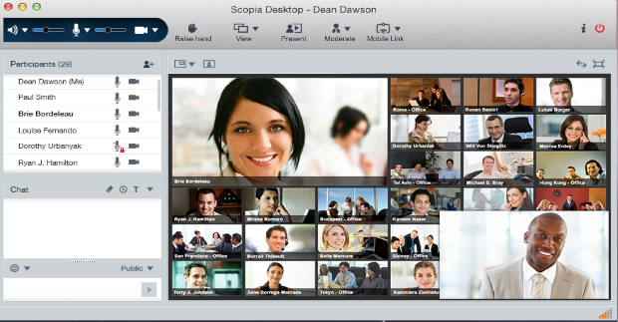
Scopia Desktop
Теперь может принимать 1080p HD
Mary Meeker, Morgan Stanley, Mar 2012
Mary Meeker, Morgan Stanley, Mar 2012
Доступно к заказу с: 1 июня, 2015
Notes:
Now with Scopia Desktop you can receive 1080p 30fps quality that traditionally has been available with room systems, Executive Desktops, or hardware-based personal systems. On top of this, remember that Avaya has 3 technologies in its Scopia soft client that improve video quality in real-world network conditions. (1) H.264 High Profile to save bandwidth. (2) H.264 SVC for error resilience. And (3) Avaya Netsense bandwidth adaptation to accommodate for bandwidth fluctuations (typically from congested 3G, 4G LTE networks, or even some public wi-fi hot spots) on-the-fly.
If any of you are familiar with the look of the client, you’ll also notice a significant change in the User Interface style, and we’ll talk more about that in a minute.

Slide 19
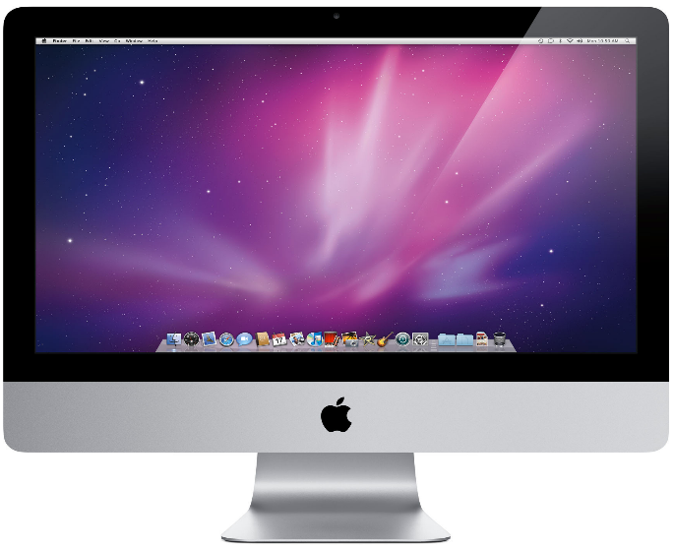

Scopia Desktop
Индикатор качества подключения
Moderate network issues.
Your meeting experience might be affected.
X
Notes:
We’re also adding a network quality indicator to easily show the quality of your connection just like you see on your mobile phone. This will give a quick realtime indication of the status of network conditions. Of course the call statistics button is still available to open a window with more detailed information about the call, but the network quality indicator gives an always visible indication just so you’ll always know what’s happening with your connection at a glance.

Slide 20
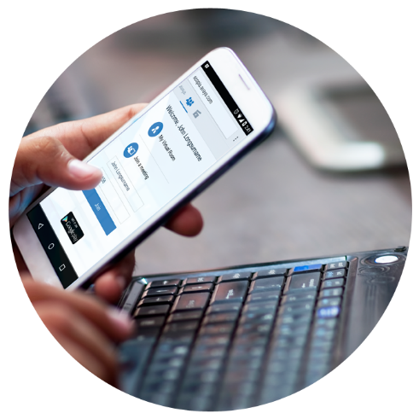

Стримминг & Запись
Notes:
We have some pretty big news with Streaming and Recording for Scopia.

Slide 21
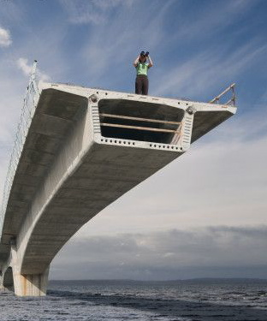
Ограничения действующие в настоящее время
Ограниченные функции
  Нет поддержки мобильных устройств
  Требует установки плагинов
  Ограничение по управлению контентом
Ограничения при масштабировании
  Нет возможности объединения нескольких Scopia Content Center
  Макс. 10 одновременных записей
Ограничения разработки
  Нет поддержки Proxy
  Стримминг только по RTSP
Notes:
Our current solution has a number of limitations.
You can’t view recordings or stream from Mobile devices.
It only works with Apple Quicktime and requires a download from Quicktime because of our decoder.
Recorded meetings are hard to find, there are no thumbnails or meta data, and its difficult to use overall.
Scalability is limited to only 10 concurrent conference recordings maximum, which might be OK for a small enterprise, but its certainly inappropriate for cloud solutions or large scale enterprises.
The design is also a bit dated using RTSP, and old protocol, no proxy support, and whenever there is an Apple Quicktime update, it has a tendency of breaking.

Slide 22


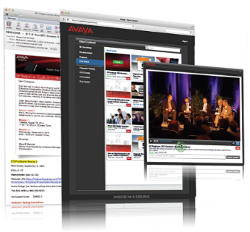
Простота стримминга и записи…
Прямая запись важных совещаний
Оповещение пользователей о записи
Воспроизведение ранних записей
Стримминг совещаний
Лучшее масштабирование – до 100,000 одновр. подключений
Mary Meeker, Morgan Stanley, Mar 2012
Mary Meeker, Morgan Stanley, Mar 2012
Доступен к заказу с: 1 июня, 2015
Notes:
That brings us to introducing the new Scopia Streaming and Recording solution where we make it easy.
The basic requirements are that Users need to have the ability to record meetings themselves.
There is also typically the legal and privacy requirement to let users know that the meeting is being recorded.
Obviously you want users to be able to easily locate and play back previous recordings.
And you want users to be able to setup streaming sessions on a self-serve basis, without involving specialized IT personnel.
Lets top that off with offering a solution with the best scalability in the market with up to 100,000 users. In comparison to offers from Polycom, LifeSize, Cisco – you see numbers of less than 10,000 live viewers.
Streaming and recording solutions can be complicated deployments since they generally involve 5 areas: capture or ingestion of the content, encoding, management, delivery & distribution, along with display or viewing the content. Avaya has packaged all this functionality into a single server solution making it really easy to deploy.

Slide 23

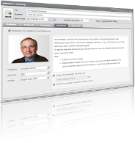

Простота стримминга и записи…
Универсальный плеер
  Без загрузки
  Видео и презентации
  iOS, Android, PC, Mac
  Совместим с Flash для старых ОС или браузеров, Silverlight, HTML5…
Планировщик
  Add-on для
  Scopia web scheduler
Запись
  С любого Scopia клиента или терминала
  Файлы в формате MP4
  1080p @ 30fps
  Поддержка Elite 6000 gallery layout
The opportunity for personal workspace is now. Customers demand a rich, collaborative user experience that is interoperable and easy to use. In addition, we believe this transaction will leverage a highly-skilled, incredibly talented and experienced workforce ready to deliver video to enterprise customers
Mary Meeker, Morgan Stanley, Mar 2012
Mary Meeker, Morgan Stanley, Mar 2012
Notes:
We have significantly enhanced the user experience
Universal Player
Zero Download for modern web browsers that are HTML5, HLS compliant.
Works native on iOS – iPhone, iPad, iWatch – joke
Along with Android devices.
If you have a down rev. browser or have security issues, we can revert to Flash, Silverlight, and Windows Media Player which are also supported.
Event Scheduling
By definition, streaming is not ad-hoc, but normally a scheduled event.
Recording is just the opposite – ad hoc, or on-demand.
Typically to stream an event, the host sends a meeting invitation out of band that requires a ton of manual work – formatting, graphics, connection links, HTML, etc. and its not automated today.
We integrated a way to schedule a streamed meeting inside the Scopia Management web scheduler to make invitations and posting live streaming events easy and compelling for the participants.
Recording
On the recording front, we have everything we have with the current solution.
You can start recording from any Scopia client or room system.
You can record any Scopia Elite MCU 5000 or 6000 meeting.
We provide a pure MP4 download for offline viewing. And you can use your favorite video editing program instead of QT Pro.
The owner of the recording can decide if users can download or not.
Recordings can be 360p, HD 720p, and full 1080p 30 frames per second for both video and the content streams.
We also offer the Elite 6000 Gallery Layout which delivers a very nice integrated recording of content and videos from the presenters – great for panel discussions.

Slide 24

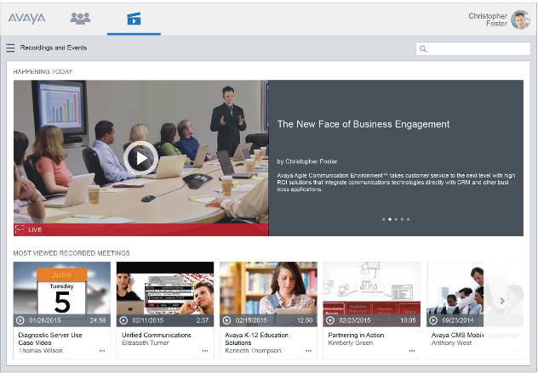
Простота стримминга и записи…
Теперь контент найти проще – портал похож на “YouTube”
Mary Meeker, Morgan Stanley, Mar 2012
Mary Meeker, Morgan Stanley, Mar 2012
Notes:
We’ve made finding and accessing recorded meetings and streamed sessions very easy with the new Streaming and Recording solution offering a YouTube like portal experience. If you can use YouTube you can use this.
We combined access to streaming (event playback) and viewing recorded content. Think of playing a stream as a recorded session being play back now for a group – instead of an individual viewing a recording.
The portal is dynamic and shows upcoming or ongoing events, most viewed and recently added recordings. Content can also be organized by user selected categories.
Users can add thumbnails, provide titles, add descriptions, and tag recordings with keywords to make them easy to find through the integrated search capability.

Slide 25
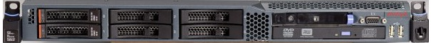
Простота стримминга и записи…
Простые предложения для малых инсталляций
«Все-в-одном»
До 10 одновременных записей @ 720p
До 5,000 подключений (Live Streaming)
До 400 одновременных просмотров (VOD - Video on Demand)
Notes:
The new Streaming & Recording solution base system is a simple all-in-one hardware appliance.
Its capable of supporting 10 concurrent HD captures – so that means any combination of streaming and recording sessions up to 10 going on at the same time.
5,000 live viewers are supported watching streamed sessions.
And up to 400 playing back pre-recorded sessions. There is a lot of disk access which is why the video on demand number is lower.
The system’s storage capacity is about 2,400 hours of 720p video and 900 hours of 1080p video.
These numbers are pending validation in the lab prior to GA in June.

Slide 26

Новые возможности Scopia Streaming & Recording
Распределенная архитектура для крупных организаций и операторов
Медиа узел
Захват, транскодинг медиа со Scopia MCU и воспроизведение клиентам и VOD
Менеджер
Middleware сервер приложений. Один менеджер на установку
До 300
(распределенные)
Notes:
For higher scale than the single all-in-one appliance provides, we have a simple product structure where we separate the solution into 2 components.
The Manager and Media Node or Nodes.
When you deploy a distributed architecture, you have a single manager that includes the middleware and application server.
And you can have up to 300 media nodes.
Media nodes capture the media.
Transcode the media from the MCU.
Deliver live streams
And deliver recorded sessions.

Slide 27

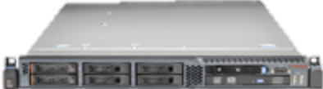
Новые возможности Scopia Streaming & Recording
Создайте свою собственную Сеть доставки контента (CDN)
Менеджер
Медиа узел
Медиа узел
Медиа узел
Медиа узел
Медиа узел
Медиа узел
Медиа узел
Медиа узел
Медиа узел
Создайте свою частную СДК установив Медиа узлы в нужных географических точках. Пользователи будут подключаться к своему локальному узлу, а доступ будет к данным хранящихся на всех.
Notes:
Customers can build their own Content Delivery Network (or CDN) by deploying Media Node appliances in their own customer locations. Then users within a location will connect to the local Media Node to access media. Customers typically create their own Content Delivery Networks for security reasons when they want to keep all their content inside on their own network.
Media Nodes capture, transcode and send content to Media Nodes inside an organization or to the ingestion point of a 3rd party Content Delivery Network.

Slide 28





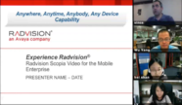
Новые возможности Scopia Streaming & Recording
Поддержка сетей других операторов
Медиа узел
(в будущем)
Notes:
Customers can also leverage and tap into a 3rd party Content Delivery Network. Initially we will support Highwinds and have plans to expand and support Akamai in the future.
These 3rd party Content Delivery Networks have servers world wide and points of presence everywhere.
A very important point is that with an Avaya solution, customers can also support a hybrid Content Delivery Network with a combination of their own Media and Delivery Nodes and leverage Highwinds capabilities as an example.

Slide 29

Новые возможности Scopia Streaming & Recording
Масштабирвоание – До 100,000 пользователей!
Управление
  До 100 Медиа узлов в режиме записи
  До 300 Медиа узлов в режиме доставки
  До 100,000 пользователей
Захват
  До 10 HD 720p сессий на 1 Медиа узел
Доставка
  До 5,000 подключений на 1 Медиа узел
  До 400 VOD на 1 Медиа узел
  До 100,000 общих подключений
Notes:
Lets review the capacities for the different modes of the solution:
A deployment can Manage:
Up to 100 Media Nodes in capture mode
Up to 300 in delivery mode
And up to 100,000 users
Each Media Node can capture up to 10 720p sessions
Each Media Node can have up to 5,000 live viewers that are watching a streamed event or up to 400 viewers watching recorded or video on demand sessions.
With up to 100,000 live viewers across an entire deployment.

Slide 30

Новые возможности Scopia Streaming & Recording Простая структура
На базе Server R2
R620 1U Шасси
2 * E5 2670 Процессор
48GB ОП
2 * 900 ГБ / Raid 1 диск
4 * GB Сетевых интерфейсов
Прединсталлированное ПО
Лицензионный ключ через PLDS
Артикул | Описание | Тип | Цена
381265 | Сервер Streaming & Recording (Включает лицензию на 1 порт) | Сервер | $ 24,500
381076 | Лицензия на 5 портов (Включает 5 портов одновр. записи, порты стримминга) | Лицензия | $ 30,000
381077 | Лицензия Менеджера (Необходима при распределенной установке.) | Лицензия | $ 20,000
381078 | Лицензия Медиа узла, 10 портов (Позволяет Медиа Узлу – захватывать и транслировать видео в распределенной структуре) | Лицензия | $ 50,000
Notes:
The new Streaming and Recording capability has a simple offering structure. First you order the appliance which includes a one port license for streaming or recording a single session. The appliance is based on Avaya Common Server R2 and comes with all the software pre-installed with a very nice design wizard that starts at boot-up. This procedure provides the Mac address used with PLDS to obtain the license.
There are 3 licenses available:
The all-in-one license enables 5 concurrent recording and streaming ports – 2 of these can be ordered for a total of 10 concurrent recording and streaming ports.
And then for a distributed deployment there is the manager license and the media node license.
The manager license enables the manager and the media node license enables capture and delivery of 10 concurrent sessions in a distributed deployment.
A good base solution would include the appliance and one all-in-one 5 port license for a total of $54,500 list.

Slide 31

Новые возможности Scopia Streaming & Recording Обновления
Текущие продукты Scopia Streaming & Recording
  Будут сняты с производства
  Доступны будут только расширение портов
  Не совместимы с новым продуктом
Миграция
  Специальные средства конвертации имеющихся записей в новый формат
Notes:
There are important upgrade considerations with the introduction of the new Scopia Streaming & Recording solution.
The current Scopia streaming and recording solution will be phased out and only port expansions will be approved.
The two solutions can’t work together. Its either one or the other.
We will have a tool to convert existing Scopia recordings to the new format to make the migration to the new solution easier.

Slide 32


Улучшенные возможности
Notes:
Now lets discuss some enhancements to the user experience with Scopia V8.3FP2.

Slide 33
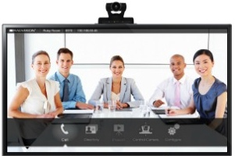

Виртуально “постучаться в дверь”
Применение – Запросить доступ к закрытой виртуальной комнате:
Вы с коллегами собрались в виртуальной комнате и заблокировали ее
Владимир хочет подключиться
Владелец комнаты будет проинформирован об этом и ему будет прдоставлен выбор (принять или отклонить)
С вашего разрешения пользователь подключается к совещанию.
Доступно с: 1 июня, 2015
Notes:
One of the nice features of Scopia’s Virtual Meeting Room capability is the ability to lock a conference room so people don’t inadvertently enter and disrupt the meeting. We have had this feature for many years. But sometimes someone arrives late that should be in the meeting. With the new knock on the door feature, late arrivers can announce they want to enter and the meeting host can let them in.

Slide 34
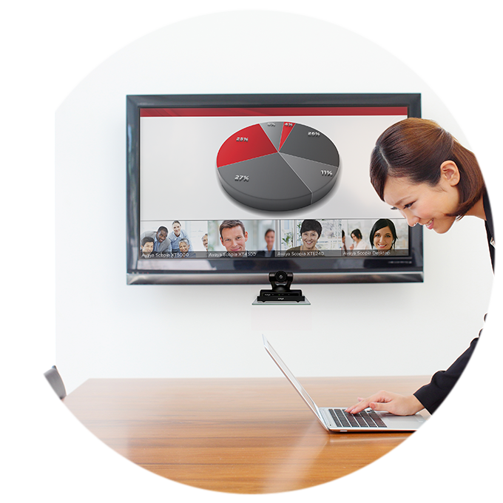
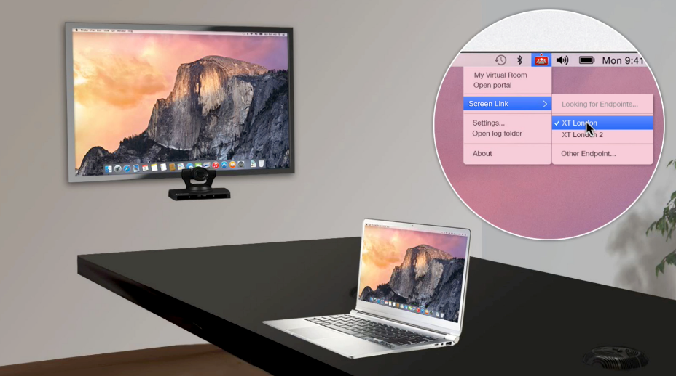
Трансляция контента без проводов через
XT Room System
поддерживаются Scopia XT4000/5000/7000
Mary Meeker, Morgan Stanley, Mar 2012
Mary Meeker, Morgan Stanley, Mar 2012
Notes:
We’ve all been there: It’s your turn to present your slides in the conference room. You first have to find the wires to connect your laptop to the video conferencing system–often, you need to pull it out of your colleague’s laptop who just presented–test that it projects on the display and to the other participants, and hope for the best.
Avaya Scopia users now have the ability to wirelessly present from their laptop–either PC or Mac–with Avaya Screen Link.
Just enter a conference room that has a Scopia room system and your laptop will automatically pair with the system using sonic recognition technology.
Anyone can present in a video meeting directly from their laptop without the need to find and plug in clumsy wires, configure their PC’s video output resolution, and fumble with the proper video out key sequence on their PC. Simply walk into a Scopia-enabled video meeting room, and your presentation can be transmitted wirelessly from your desktop to the Scopia room system.
Oh, and this capability exists whether you are in a video conference or not. Think of the value of being able to use high-resolution displays to show content in a conference room–to either the people sitting in the room with you or to everyone on a video call. Simple. And pretty cool.

Slide 35
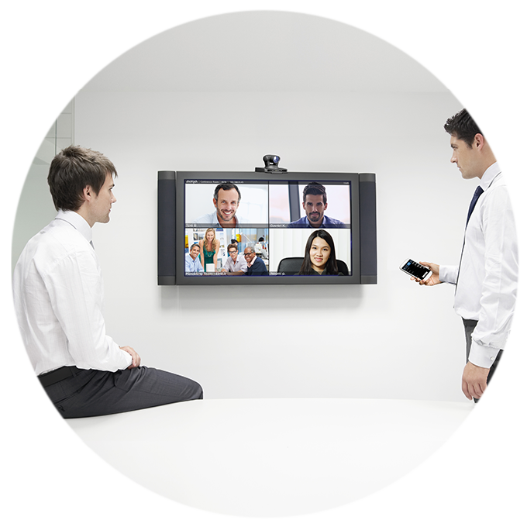
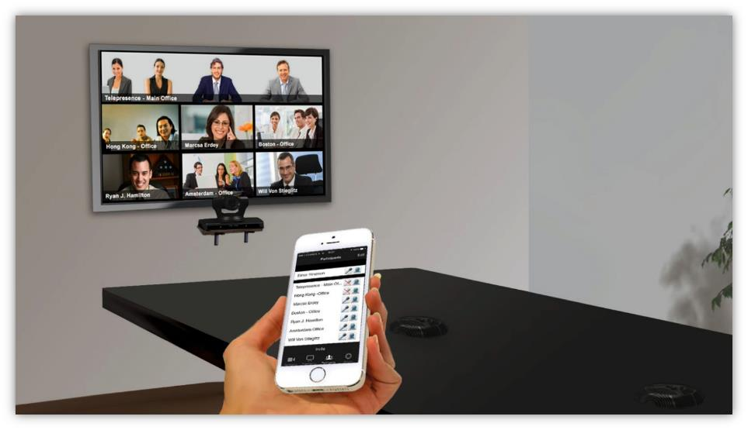
Подключитесь к совещанию на мобильном а продолжите на терминале в зале.
Avaya Mobile Link
Mary Meeker, Morgan Stanley, Mar 2012
Mary Meeker, Morgan Stanley, Mar 2012
Notes:
Here’s another all-too-common video conferencing scenario:
It’s your first meeting of the day, so you dial in on your smartphone while driving to the office. When you arrive at the conference room, you have to get off the call on your smartphone, search for the dial-in information and manually connect to the same meeting using the room system.
With Avaya Mobile Link, your mobile device automatically pairs and transfers the meeting to the Scopia room system, allowing you to enjoy the room system’s crystal-clear audio, HD camera and large display.

Slide 36

Улучшения планирования в Outlook
Scopia Desktop Add in более не доступен
Доступен только Scopia Management Add in
  Поддержка Office 64 бит
  Установка с сервера Scopia Desktop
  Подключение к серверу Scopia Desktop (VPN не нужен)
  Поддержка HTTPS
2 режима
  Простой (похож Scopia Desktop)
  Улучшенный (приглашение терминалов, резервирование ресурсов …)
Scopia Management теперь обслуживает все совещания.
Notes:
I suspect that some of you have first hand experience with some of the difficulties in using the current Scopia Desktop Outlook plug-in for scheduling; and multiple add-ins were confusing. The Outlook plug-in for Scopia Desktop will be phased out, in favor of the Scopia Management plug-in. Here we will support more use cases where the Desktop plug-in had issues including
64 bit Microsoft Office support
Installation from the Desktop
Can be used without VPN connectivity
And it also supports HTTPS redirect
There will be 2 modes:
A simplified mode like Scopia Desktop has today,
and an Advanced mode leveraging Scopia Management’s sophisticated capabilities including the ability to reserve resources such as MCU ports, and automatically invite room system endpoints.
Another important aspect is that Scopia Management is now aware of all system meetings.

Slide 37

Упрощенное лицензирование
Лицензии больше не привязаны к пользователям – Все включено
Вы покупаете
  Набор Elite MCU SW
  или
  Лицензии Scopia Management
  или
  Лицензию Scopia Management alternate
Получаете
  Неогран. Кол-во¹ Мобильных клиентов
  Неогран. Кол-во¹ клиентов для ПК
  ¹ ограничиваются только портами MCU
Notes:
We make Scopia user licensing really easy now.
You buy the MCU and you either purchase the Scopia Elite MCU Software package or the Scopia Management license and you get unlimited mobile and desktop seats – we’re not counting them anymore. Everyone is mobile enabled. The limit to the number of concurrent users for Scopia Desktop and Mobile is the number of MCU ports in the deployment.

Slide 38
Улучшенная масштабируемость
5,000
Одновременных звонков через MCU
Notes:
This slide speaks for itself. Scalability in the Scopia solution for V8.3 Feature Pack 2 has been expanded from 3,000 to 5,000 concurrent Multi-party calls. With a 10 to 1 ratio of users to concurrent calls, a single deployment supports 50,000 users.
And that’s a lot of calls and a lot of users.

Slide 39
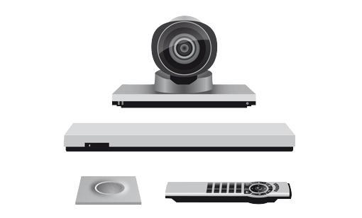
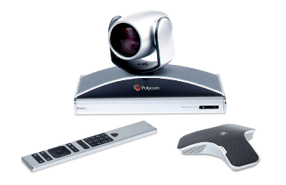
Scopia Management
Поддержка систем 3^{их} производителей
Серия терминалов Cisco C
Серия терминалов Cisco SX
Серия терминалов Polycom RealPresence Group
Notes:
Scopia Management also has enhanced capabilities to open the door of Cisco and Polycom accounts with expanded management of 3rd party room systems. Now Scopia can manage the Cisco C and SX Series Room systems, in addition to Polycom’s RealPresence Group Series room systems.
One thing I’d like to also point out is that we have a clear advantage over Cisco in that they don’t support management of any Polycom endpoints.

Slide 40

Scopia Management
Учет терминалов
Генерирование отчета по имеющимся терминалам, в котором содержится:
  Модель
  Версия
  Mac адрес
  И пр. информация
Notes:
We have a new feature that makes it much easier for customers to determine the endpoints that are in their deployment.
One click generates a CSV file that can be used in Excel that lists all endpoints including models, versions, mac addresses, and additional details.

Slide 41

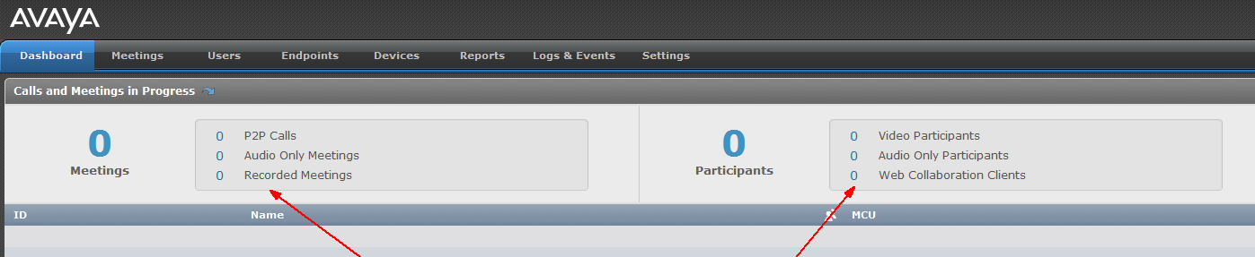
Scopia Management
Новые возможности при поиске неисправностей / Мониторинге
Возможность генерировать отчет для системы мониторинга других производителей, например: HP Operations Manager (OM)
Добавлена опция «пригласить повторно всех участников кто в статусе офлайн»
Дополнительная инфомрация в панели управления
Notes:
We thought SNMP was what customers wanted for troubleshooting and integration into other monitoring tools, but over time we found that they really want to parse logs for integration.
With this new capability, you get all the context instead of single messages to tell what actually happened. A great example is a connection failure. Connection failures happen in a deployment and you always get them. But if there is a rate or pattern of them, then it means something, now these issues are visible in a separate troubleshooting log as a group instead of individual error indications one at a time.
Administrators can generate problem tickets very quickly with this capability.
There is a new capability that makes it easy if for example, you schedule a meeting with say 25 endpoints and only 20 of them connect, then you can re-invite all the ones that didn't connect with a single click.
And now there are also more details in the Scopia Management dashboard.

Slide 42
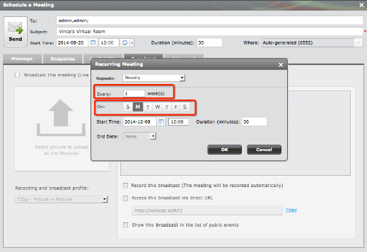
Scopia Management
Улучшены возможности повторяющихся совещаний
Добавлены новые возможности в web планировщик, поддержка исключений
Возможность изменять повторяющиеся совещания (доп. команды)
Notes:
With the web-based scheduler of Scopia Management, we added a number of patterns to make scheduling recurring meetings easier – along with being able to handle exceptions to them.

Slide 43

Scopia Management
Улучшения для облачных решений
Super Admin теперь имеет возможность сбросить пароль администратора подписчика
Улучшены опопвещения об истечении пароля
Возможность отключить планирование конференций не связанных с VMR
Облачные технологии
Расширение API
Super Admin теперь может управлять организациями
Глобальный IVR облаков
Notes:
For those of you selling to service providers, multi-tenant or VaaS deployments, here are a few specific enhancements for reference that you may be interested in. I’ll pause on this slide for a moment for you to check it out on your own.

Slide 44


Взаимодейстие по WEB
Notes:
The Scopia platform today uses H.239 which delivers complete room system interoperability for data collaboration; but we have pushed those capabilities to the limit and are introducing new advanced web collaboration features with version 8.3 feature pack 2.

Slide 45

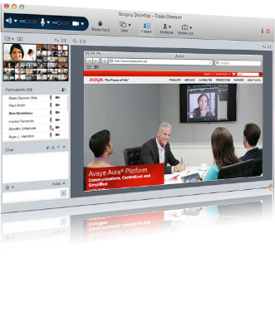
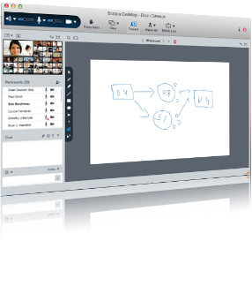
Взаимодействие по WEB
AAC Web Collaboration интегрирован со Scopia
Улучшенно качество
Показ отдельного приложения
Показ части экрана
Комментарии нескольких
Виртуальная доска
Управление удаленным рабочим столом
PC и Mac
Возможность выбора какой экран передавать если подключено несколько
H.239/BFCP шлюз
Mary Meeker, Morgan Stanley, Mar 2012
Доступно с: 1 июня, 2015
Notes:
We've taken the dual stream video conferencing approach to content sharing as far as we can go – including capabilities such as slider where you can go back and review previously presented content on the fly without interrupting the meeting flow. Now users will have a much richer collaboration tool set than with video-centric H.239 / BFCP content sharing capabilities.
We will be offering the rich web/data collaboration experience from our AAC solution within the Scopia solution. Features will include white boarding, application sharing, you can choose which screen to share with multiple monitors – which is becoming more prevalent with users docking their PC tablets and ultrabooks and using both displays. Also, this enables remote desktop control – where a user sharing their desktop can also share their keyboard & mouse with one other meeting participant.
We can’t forget all the H.323 and SIP systems, and one of the key developments data collaboration gateway functionality for room system interoperability.

Slide 46
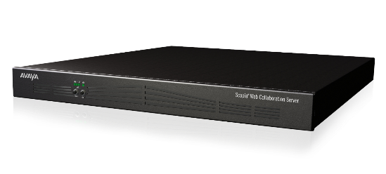
Scopia Web Collaboration
Сервер Web Collaboration
Один сервер для Scopia Elite 6140 или Elite 5230
  До 160 одновременных подключений
  До 50 одновременных конференций
Встроенный шлюз H.239/BFCP
Артикул | Описание | Тип | Цена
55548-00050 | Web Collaboration Server Appliance | Сервер | $ 15,000
88548-00050 | Web Collaboration Server License | Лицензия | $ 20,000
88548-00850 | Web Collaboration Server License - NE | Лицензия | $ 20,000
Notes:
The new web collaboration is delivered as an appliance for installation simplicity.
Pricing and ordering is simple.
First you order the hardware appliance, and then you select the server license. In most countries you will select the standard server license. In countries where shipping encryption is restricted, you order the NE or non-encrypted version. Each MCU in the deployment where this new capability will be available requires a server and associated license.

Slide 47
New Scopia Web Collaboration
Подробнее
Web Collaboration поддерживается клиентам Scopia Desktop
Пользователю необходимо загрузить плагин с портала Scopia Desktop для трансляции контента через Web Collaboration
Для Scopia Mobile пока без изменений
Web Collaboration сервер транскодирует презентации в/из H.239/BFCP для совместимости с терминалами Scopia XT и других производителей
Режим обслуживания
  Если сервер WEB Colaboration находится в режиме обслуживания, то используется стандартный протоколо H.239
Notes:
Some details on the new web collaboration features:
It will be supported by Scopia Desktop and users will download and install the new Web Collaboration plug-in.
For this release, Scopia Mobile users will experience collaboration as they do today.
Very important for interoperability is that the Web Collaboration server will transcode to and from H.239 and BFCP for H.323 and SIP endpoints.
If the new web collaboration is turned off or not available, today's standard H.239 presentation mode will be used.

Slide 48
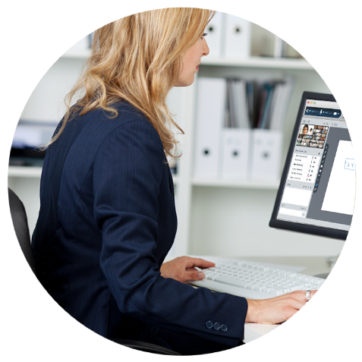
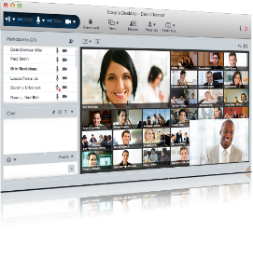

Scopia Desktop
Унифицированный пользовательский интерфейс
Mary Meeker, Morgan Stanley, Mar 2012
Mary Meeker, Morgan Stanley, Mar 2012
Notes:
And the last enhancement we'll talk about today is that we plan to provide a unified look and feel to the user experience across all the Avaya offerings and Scopia Desktop and Mobile will adopt that experience also. With a clean gallery layout it will have the same look and feel as other Avaya solutions including Avaya Aura Conferencing.

Slide 49


Обзор Scopia V8.3 FP2
Портфолио терминалов
увеличивается
Терминал Scopia XT4300 (Анонс: 6 апреля)
Новая система для комнат малых и средних размеров, позиционируется между XT4200 и XT5000 по конкурентной стоимости
Идеально для небольших переговорок
Поддержка HD 1080p/60 в 2-х потоках одновременно, 5x зум, подключение 1 камеры.
H.264 High Profile и H.264 SVC
Поддержка 2-го экрана, опционально
Встроенный MCU-4, опционально
Терминал Scopia XT7100 (Анонс: 27 апреля)
Новый флагман в линейке оборудования
HD 1080p/60, 10x зум, 2 входа для камер
H.265 для экономии 50% полосы по сравнению с H.264 High Profile
Поддержка 2 экранов
Встроенный MCU-9
Повышение кач-ва (Анонс: 1 июня)
Качество терминалов 1080p на компьютерах
Простой стримминг и запись
    Универсальный плеер
    Загрузка видео в формате MP4
    Портал похожий на “YouTube”
    Наилучшая масштабируемость 100,000 одн. Польз.
Улучшенное использование
    Беспроводная передача контента через терминал
    Переключение конференции
Интеграция Scopia и AAC
Объединение возможностей AAC и Scopia
Больше возможностей по сравнению с традиционными H.239/BFCP
Унифицированный Avaya интерфейс клиентов
Notes:
Lets close with a review of the details on Scopia V8.3 Feature Pack 2.
Avaya’s video conferencing room system portfolio expands with 2 additional endpoints – the Scopia XT4300 and the Scopia XT7100.
The XT4300 is a mid-range system positioned between the current XT4200 and XT5000 and makes high quality dual HD 1080p60 available to more users, in more rooms, with lower budgets.
The XT7100, Avaya’s new flagship room system, is one of the industry’s first endpoints with H.265 video, delivering the same performance as H.264 High Profile, but with up to a 50% bandwidth reduction – providing a significantly lower impact on the network for lower operating costs.
For Increased Quality, Scopia Desktop moves up from 720p to 1080p which provides room system like video quality to PCs and Macs..
Our new streaming and recording solution offers highly scalable streaming, support for common media formats making recordings incredibly portable, along with YouTube like accessibility.
Users can now wirelessly share content from their laptops to video conferencing room systems – making it really convenient to present;
and mobile users can start their meetings on the go – and continue them on a room system without skipping a beta with Mobile Meeting Continuity.
And we are quickly moving along the path of combining the best of Scopia with the best of Avaya Aura Conferencing bringing a much richer set of web collaboration tools beyond video-centric screen sharing with H.239
So with Scopia video, we have a very attractive package of enhanced capabilities coming in the next few months.

Slide 50


Благодарю
за внимание!

